Slide 1

MMS Jazz Recap
Andrew Jimenez
Twitter: @AndrewJimenez_

Slide 2
Who Am I?
A little bit about me

Slide 3
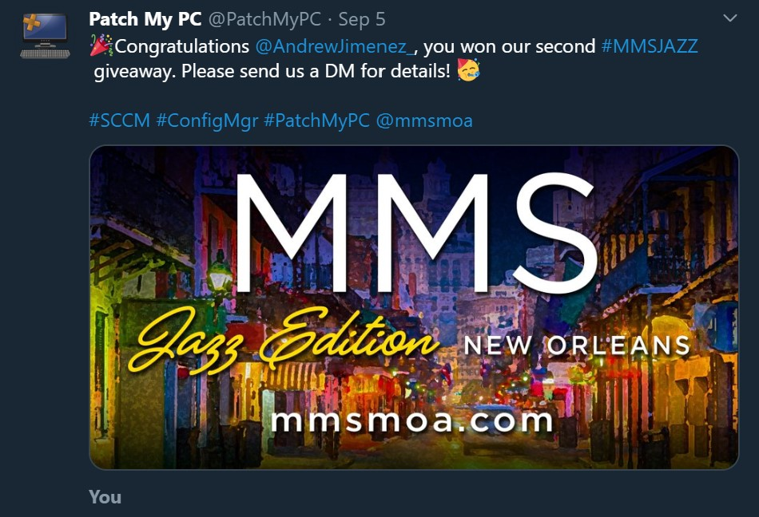
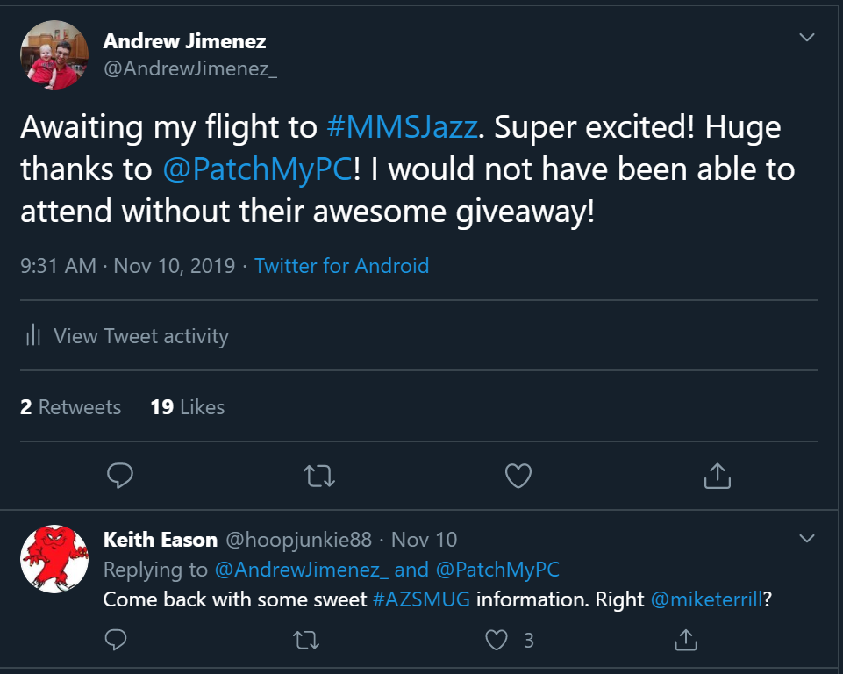
Winner of PatchMyPC MMSJazz Giveaway!
Thank you PatchMyPC! Today’s sponsor!

Slide 4
What is MMS???

Slide 5
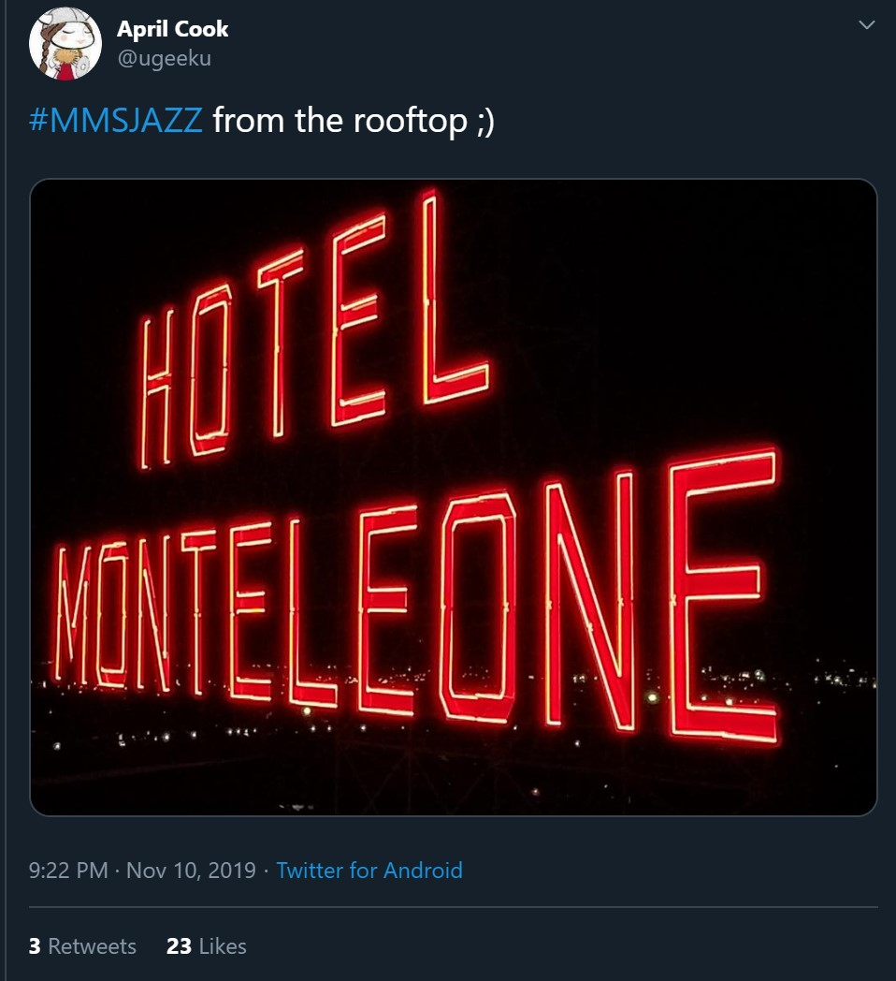
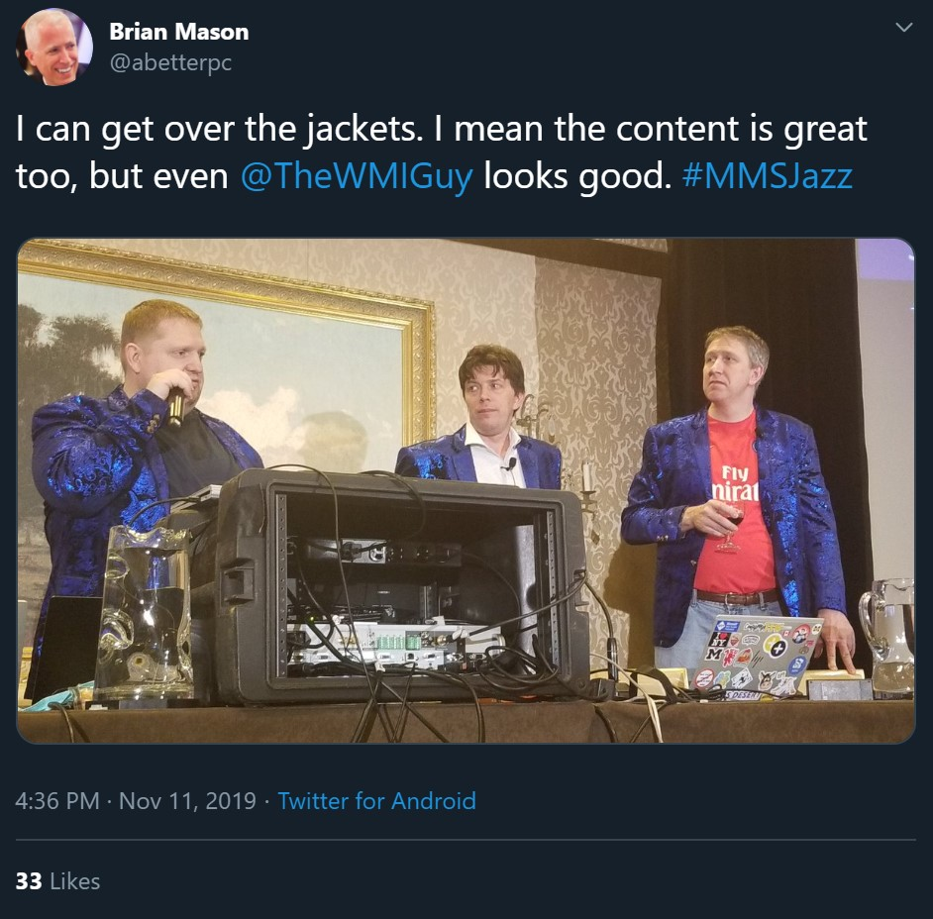
What is MMS?
Conferences dedicated to Microsoft management technologies (ConfigMgr, Intune, MEM)
Two conferences a year
MMSMOA
4 Full Session Days
Travelling conference is smaller and shorter
3 Full Session Days
All sessions have 2 speakers and extended Q&A
New Orleans at the Hotel Monteleone
Beignets
Jazz (Duh!)
Blue Jackets
Did I mention BEIGNETS???

Slide 6
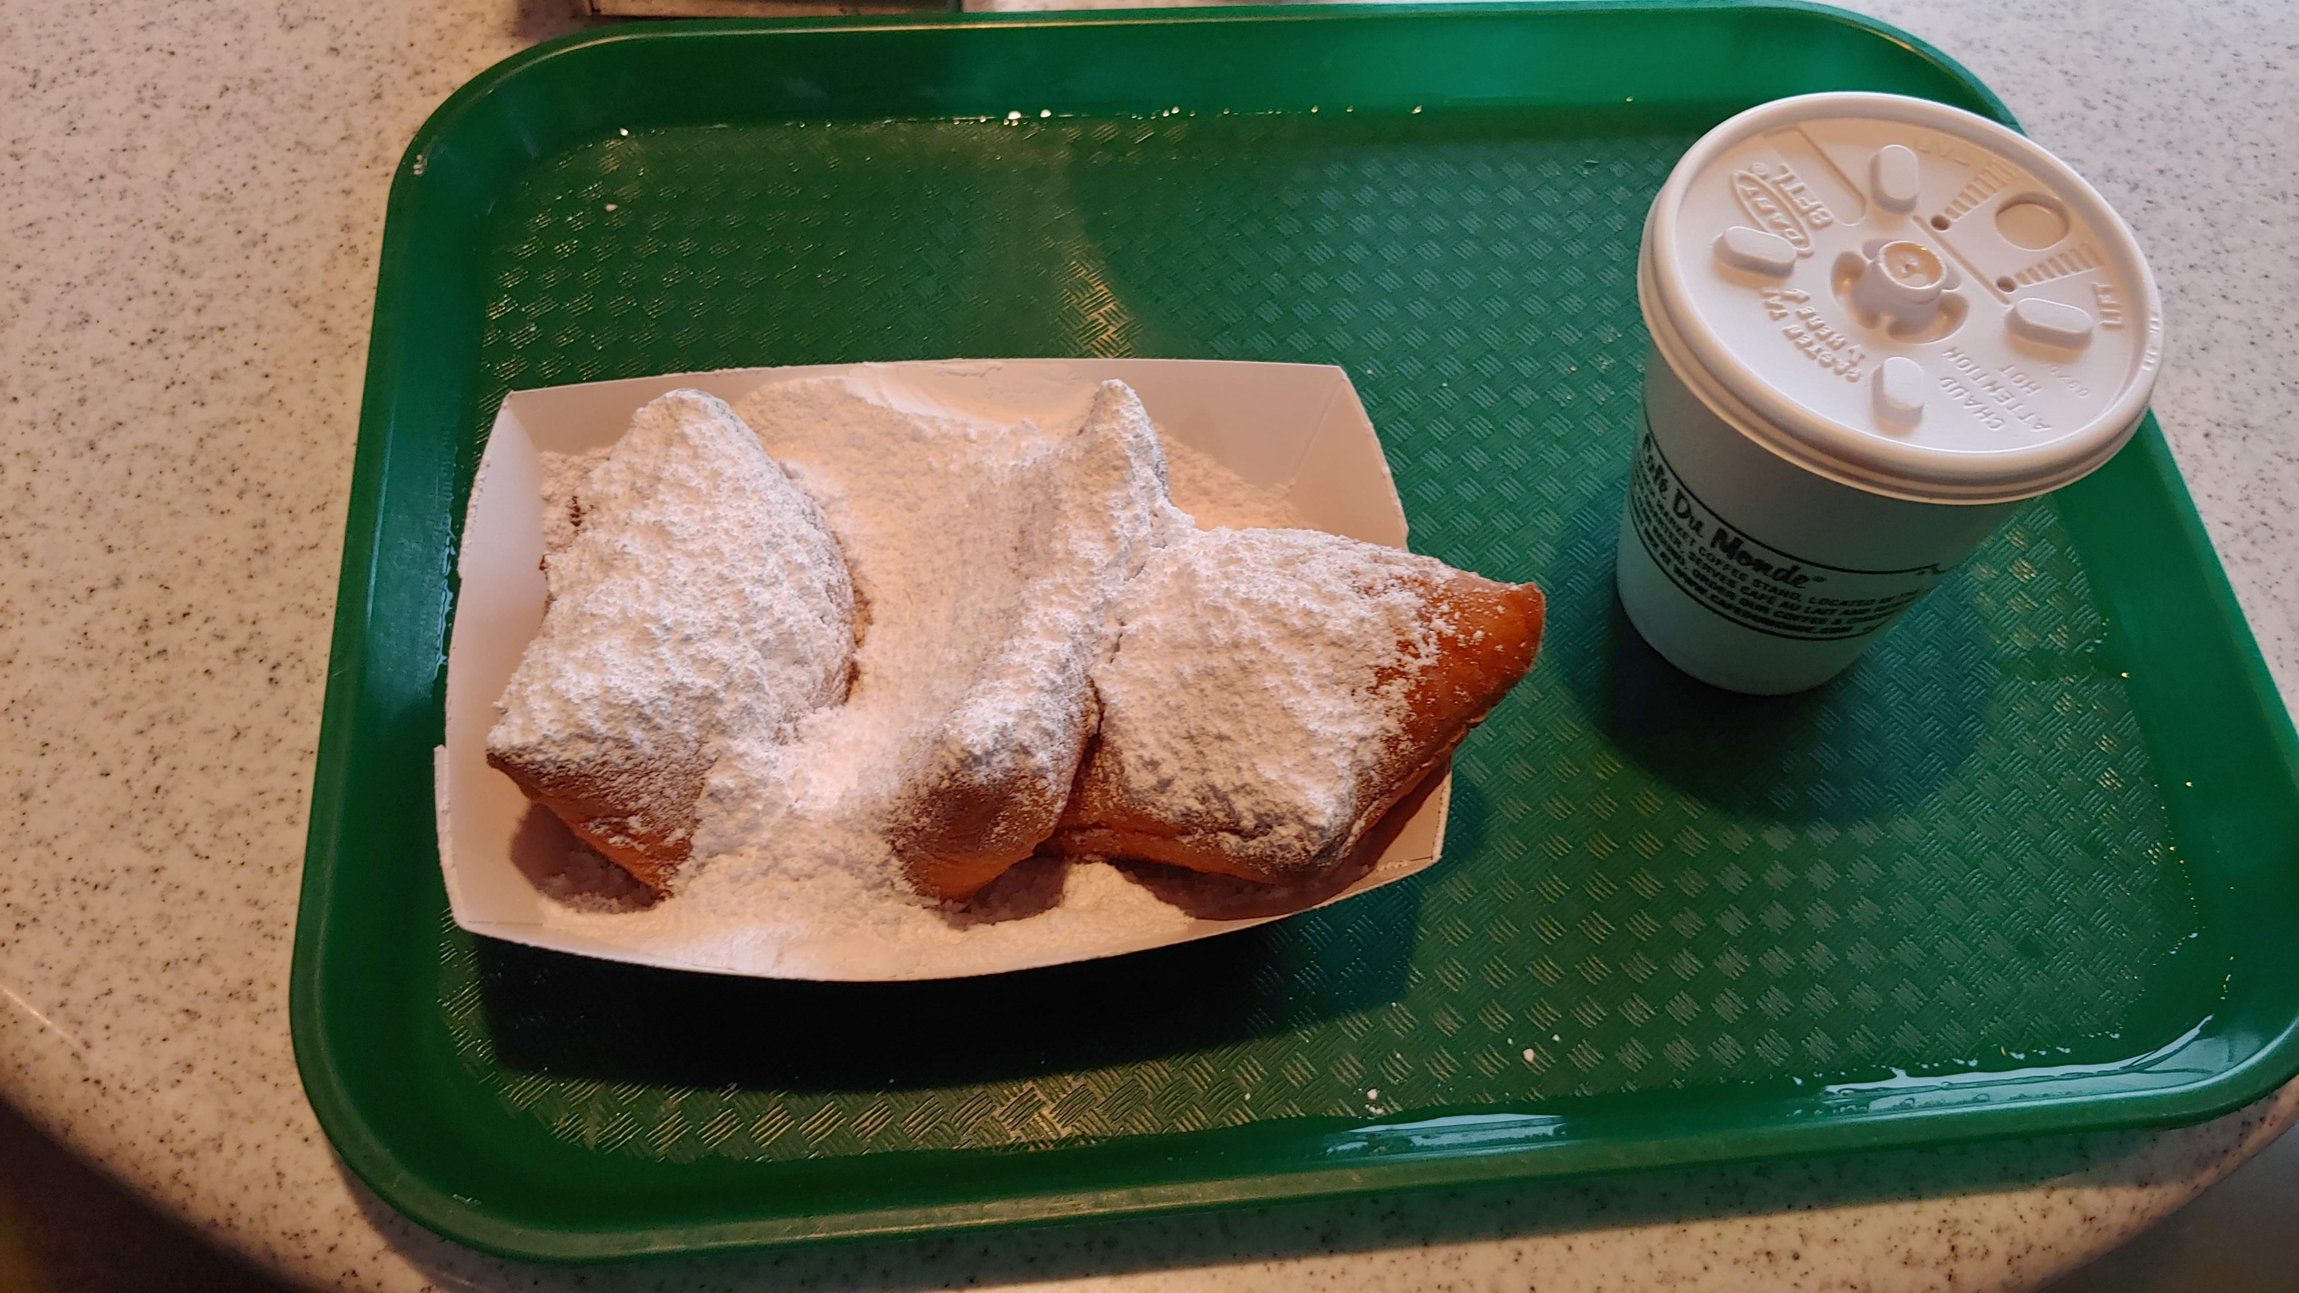
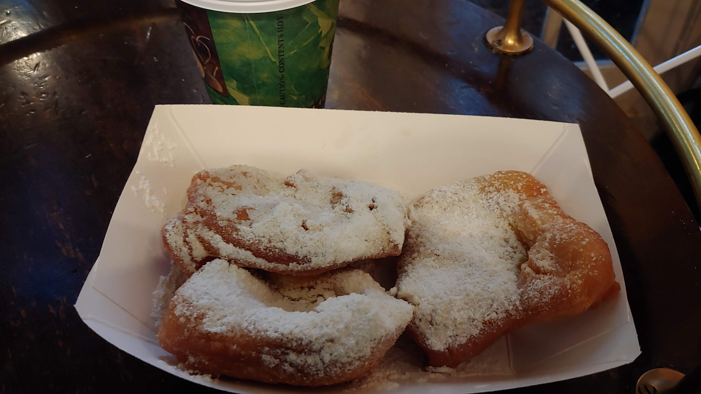
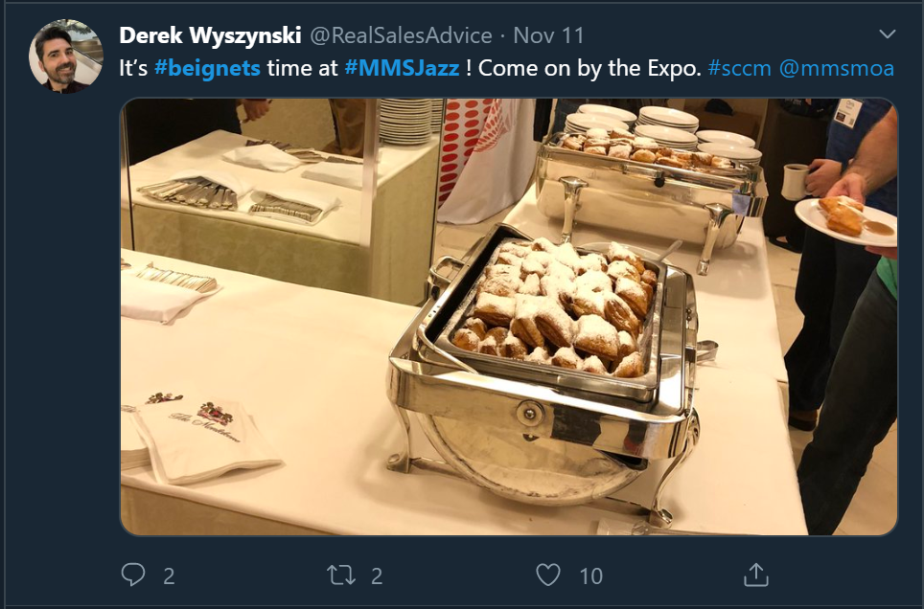
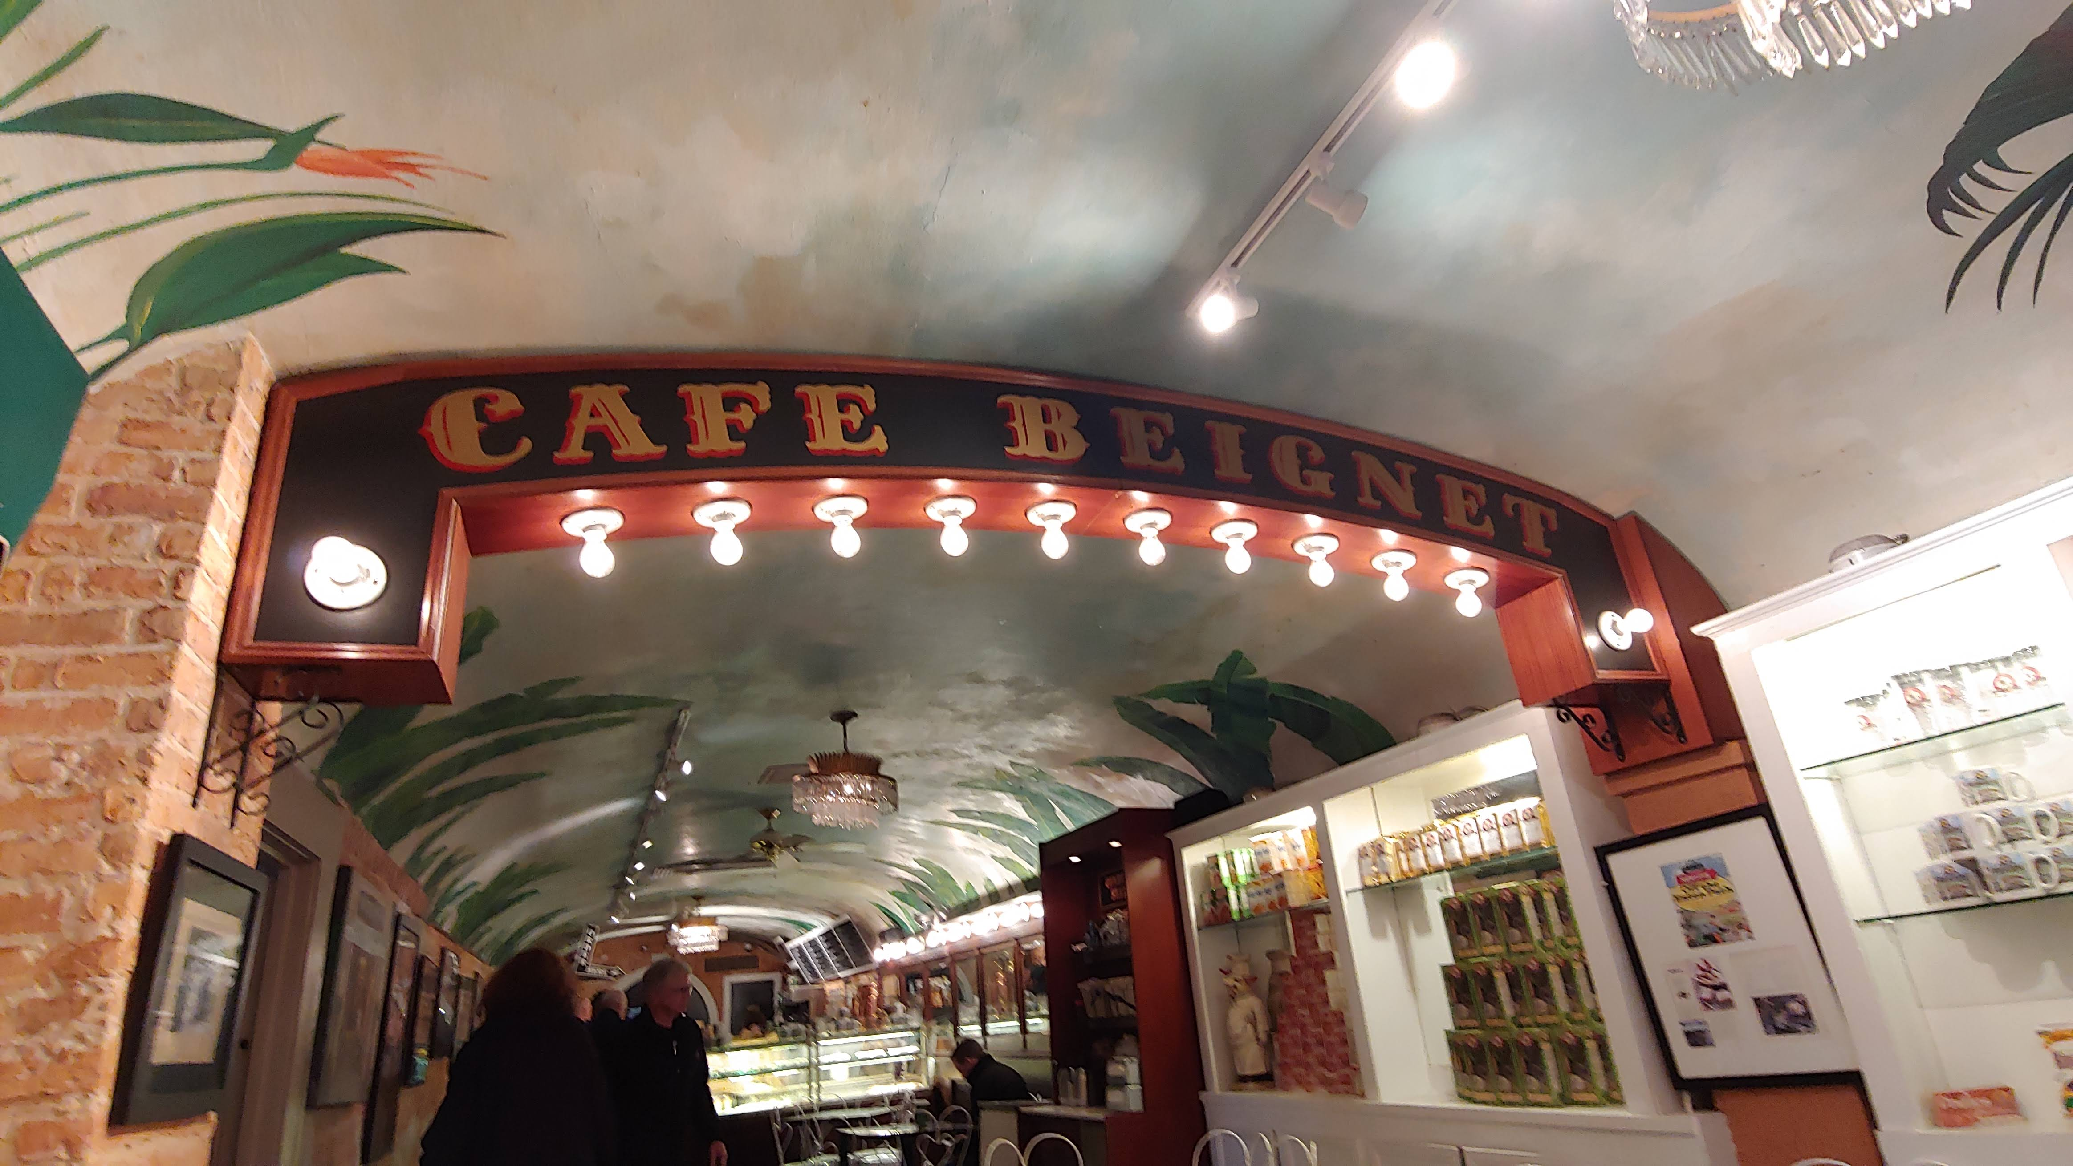
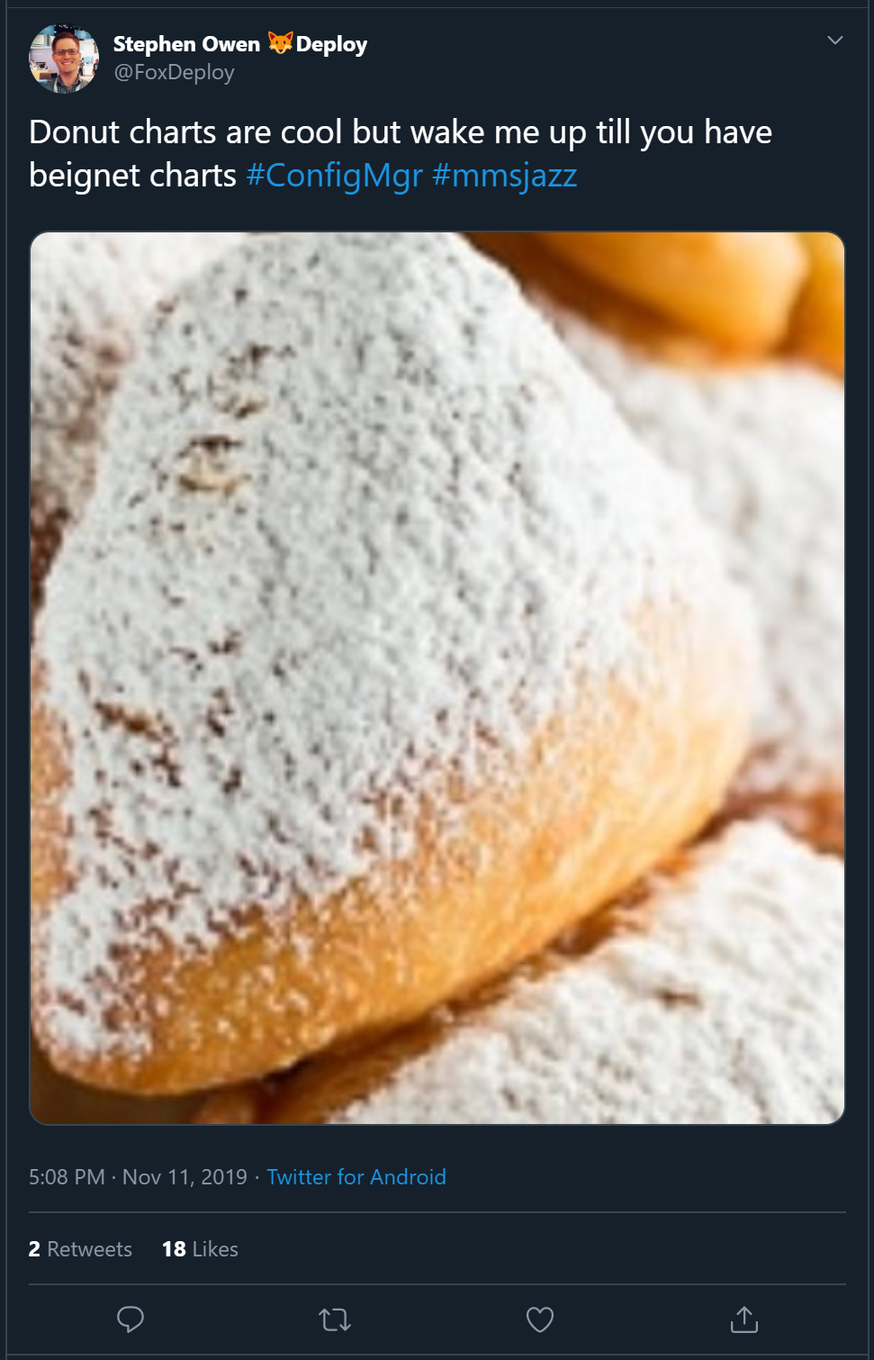
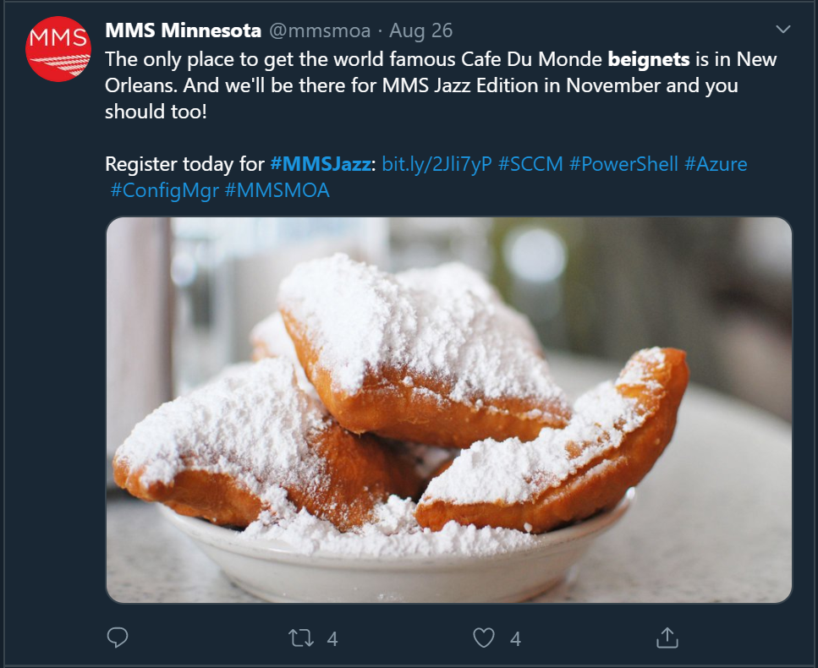
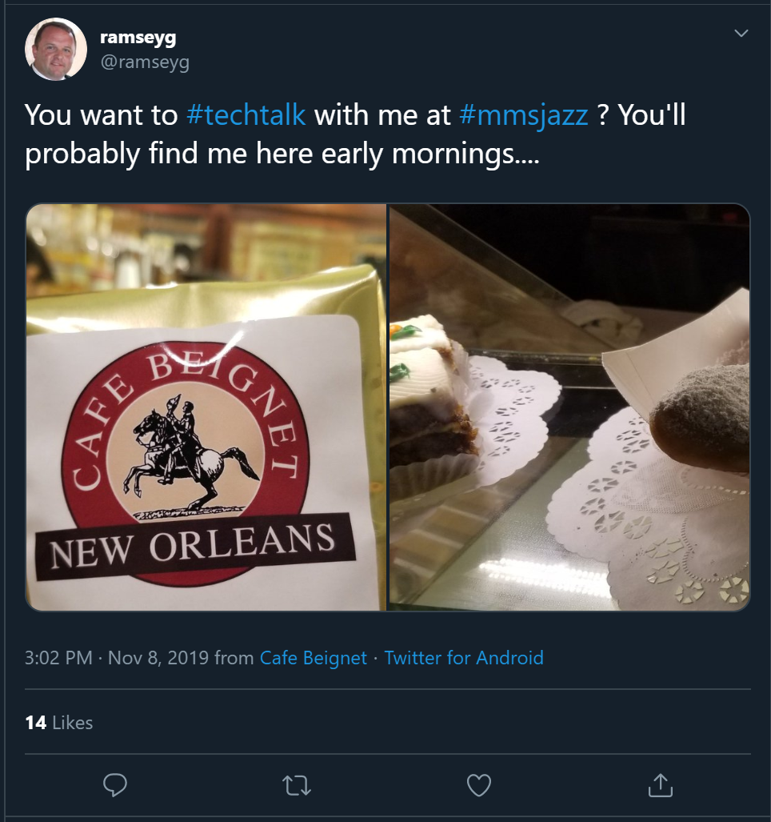
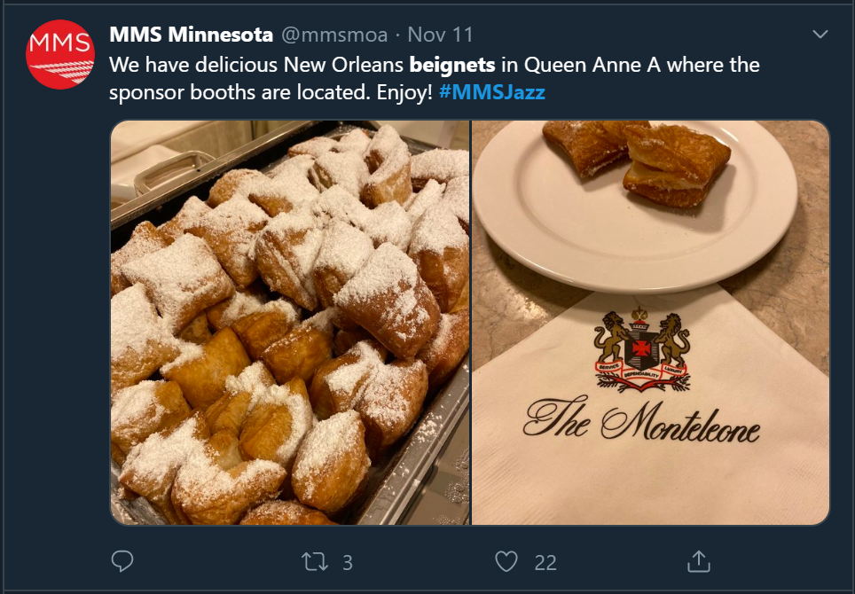

Slide 7
Q&A Thank you!

Slide 8
Background Info
Some things to know

Slide 9
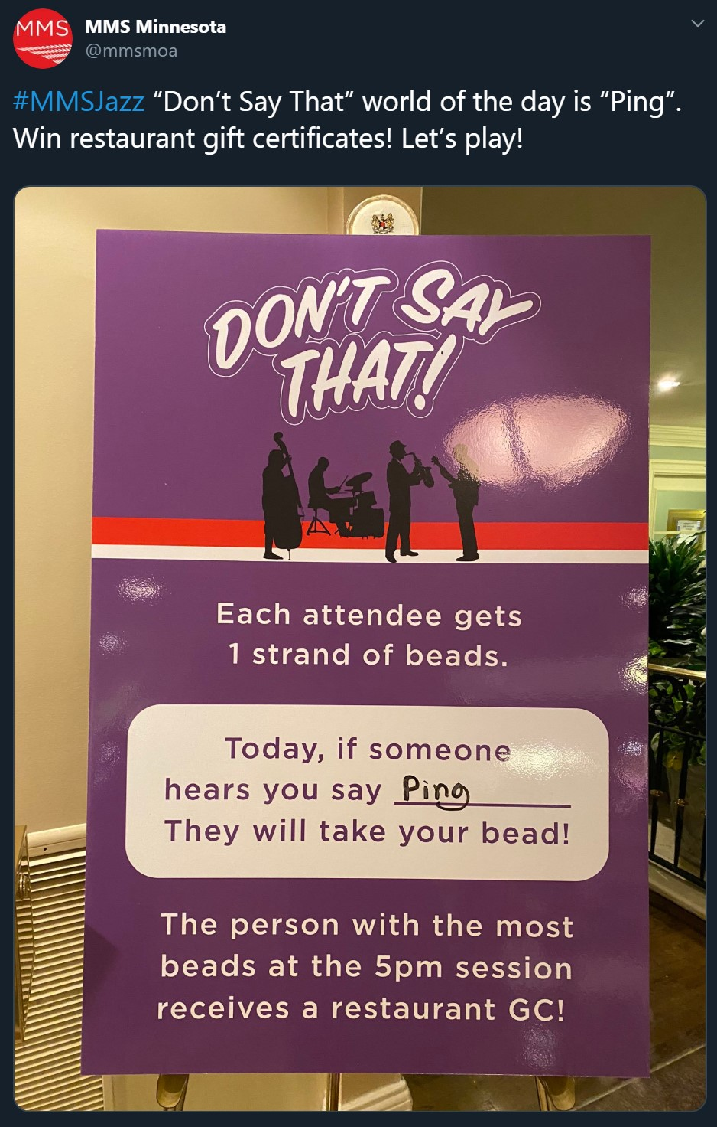
Word of the Day
Everyone starts with 1 bead necklace
If someone catches you say the word of the day, they can take your beads!
Whoever has the most beads at the end of the day wins a prize
Speakers are not exempt!
If I say any of the words of the day during this presentation, you can take a bead necklace from me
I have no prizes

Slide 10
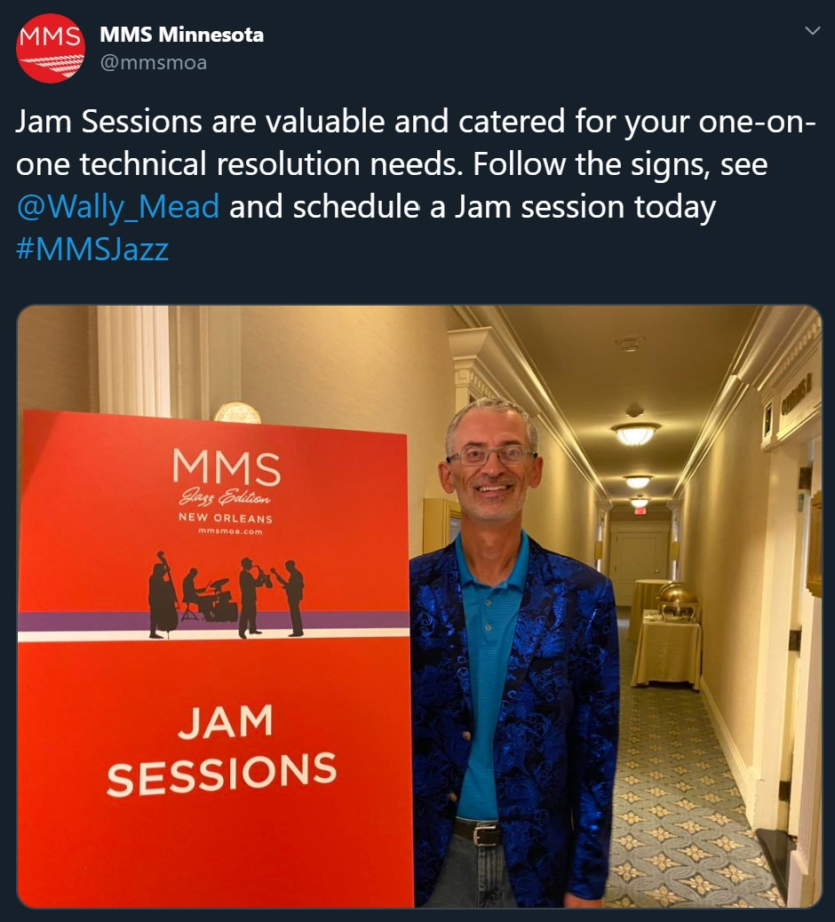
Jam Sessions
Technical sessions with speakers and Microsoft employees who work on the product
Discuss problems, bugs, or improvements/ideas
Get bugs and annoyances in MEM fixed
Make suggestions and have highly technical discussions
Jam sessions were coordinated by the one and only Wally Mead!
Wally controlled the sign-ups
He had bacon (and other goodies)

Slide 11
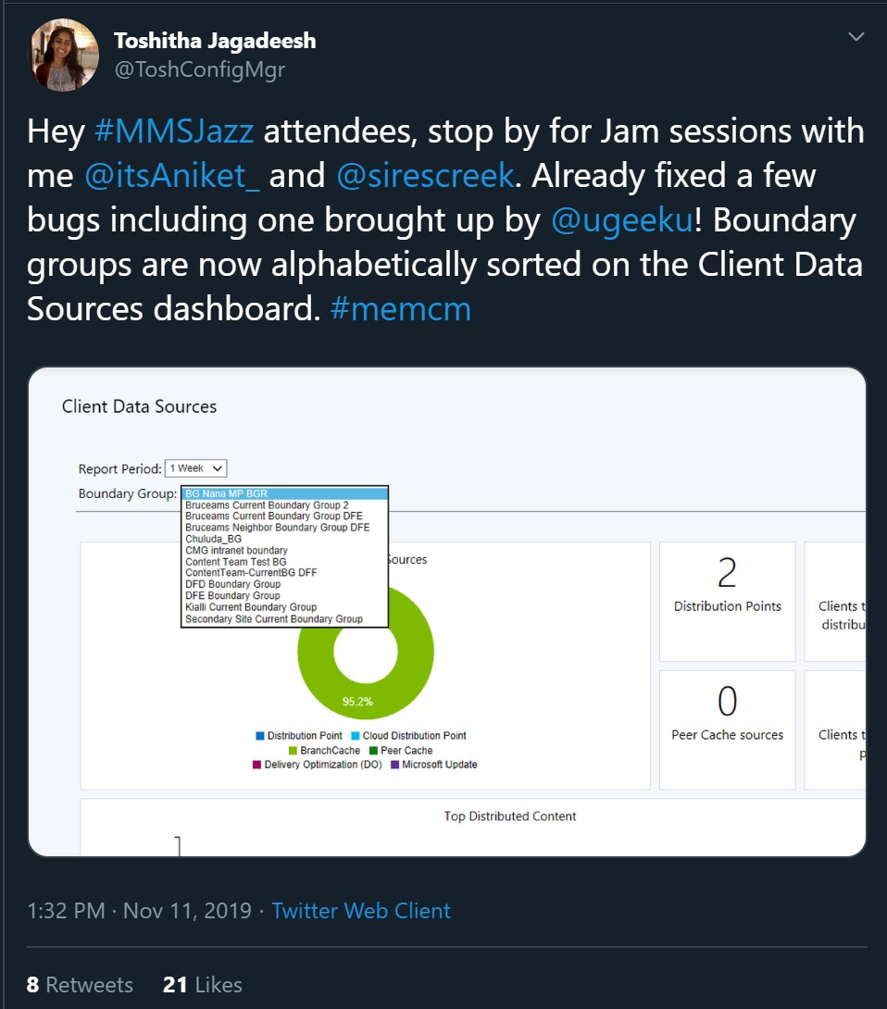
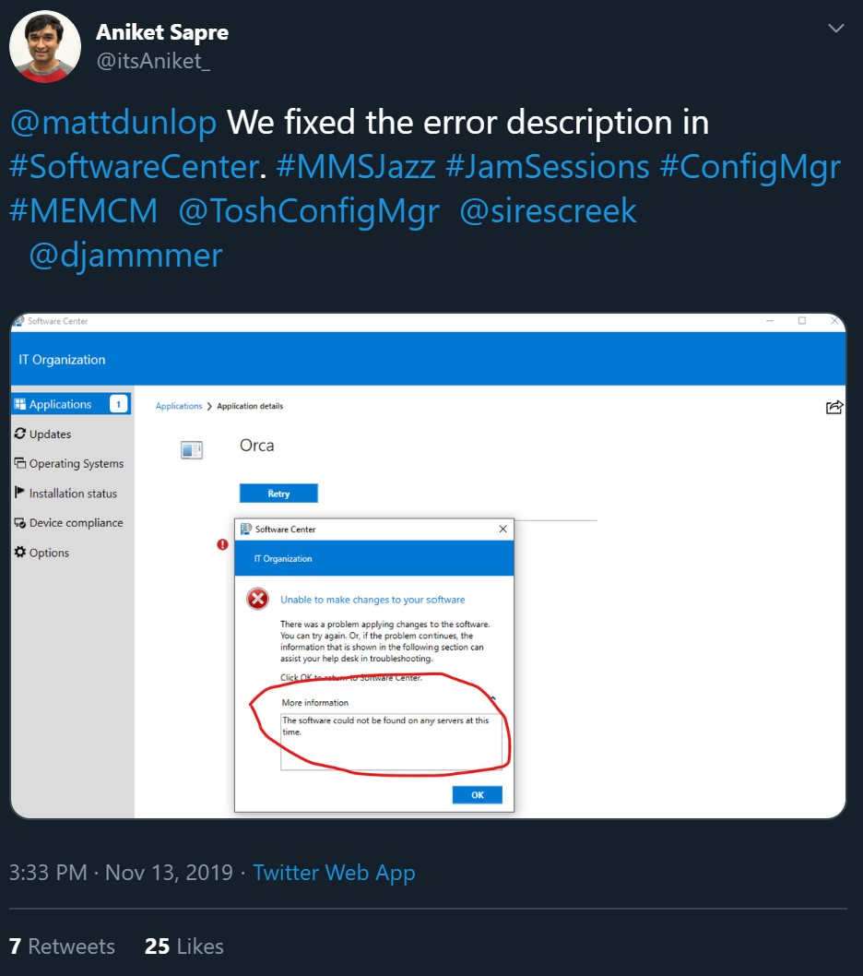
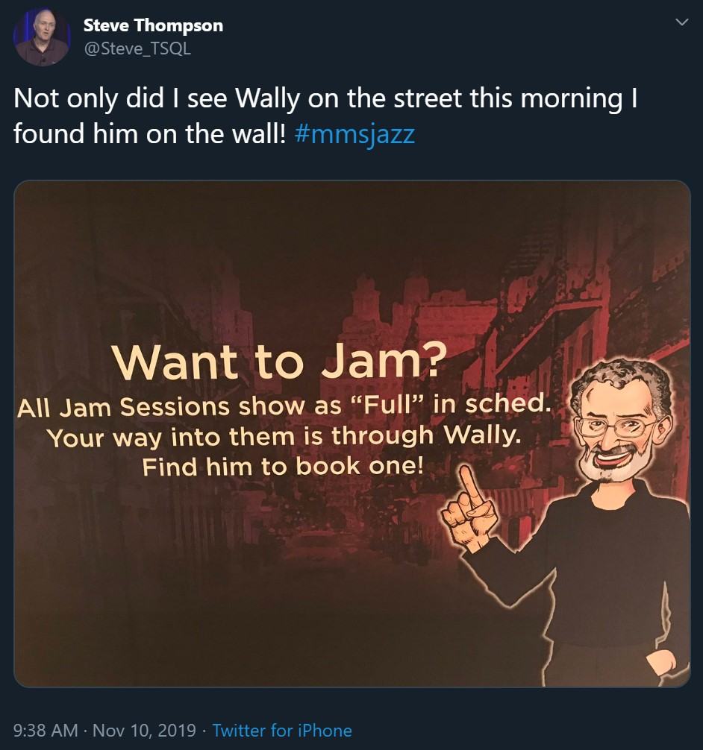
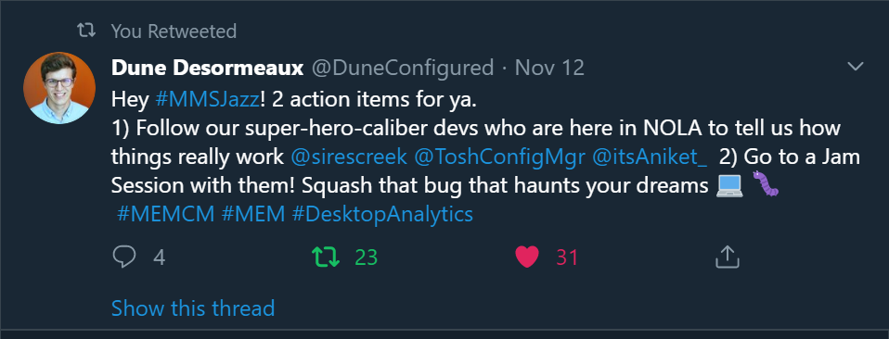
Jam Sessions

Slide 12
Day 0
November 10th, 2019

Slide 13
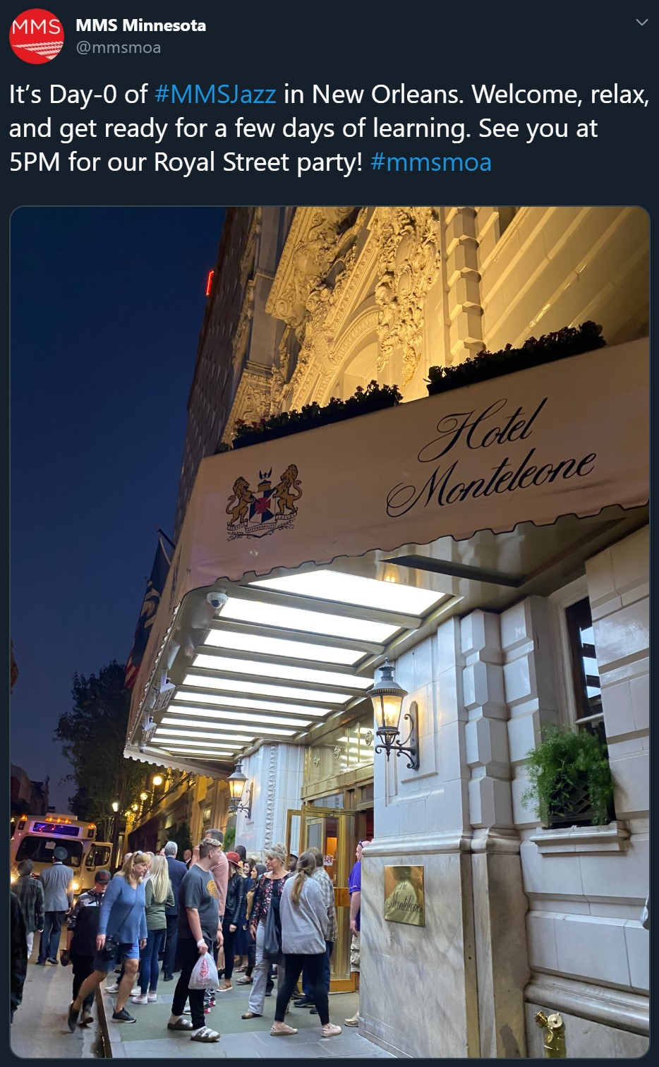
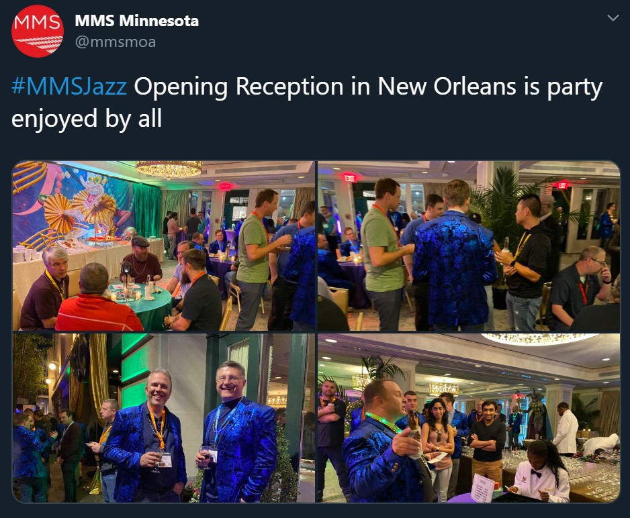
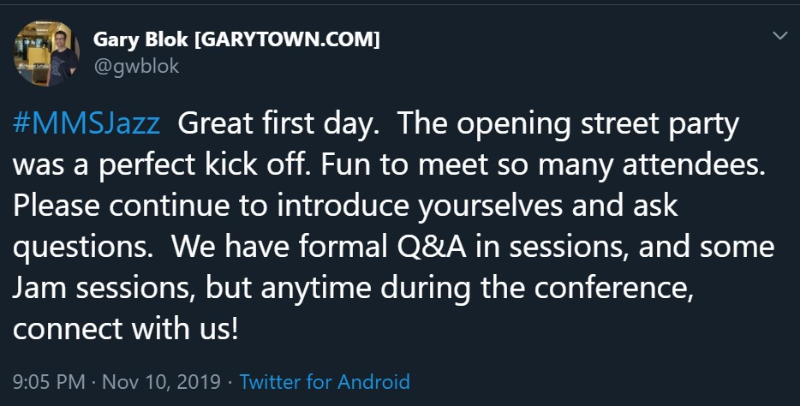
Day 0
Arrival and Street Party!
Meet and chat with attendees and speakers
Eat awesome food and get drinks
Get stickers of Adam Gross’ face
Go to bed!
Cough a lot…

Slide 14
Day 1
November 11th, 2019

Slide 15
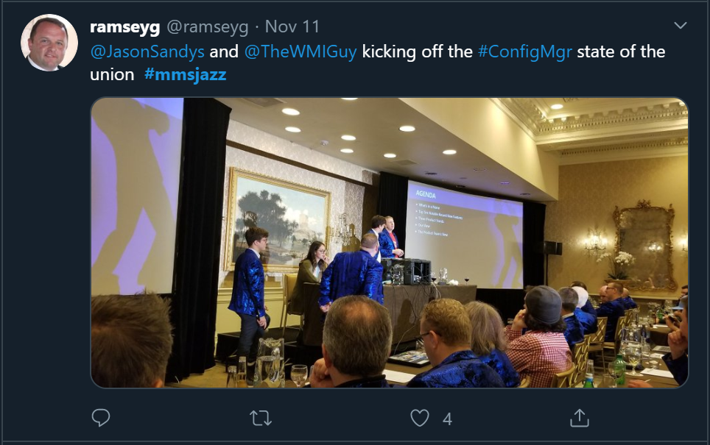
Day 1
Word of the day: ping
ConfigMgr Admin Service Adam Gross is hype
ConfigMgr state of the union

Slide 16
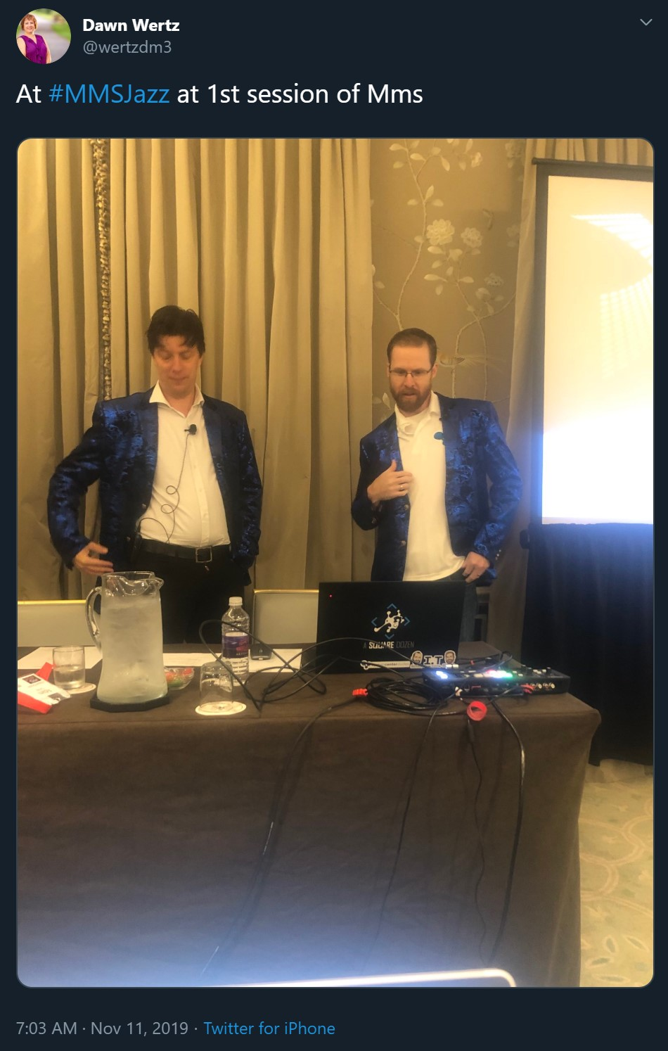
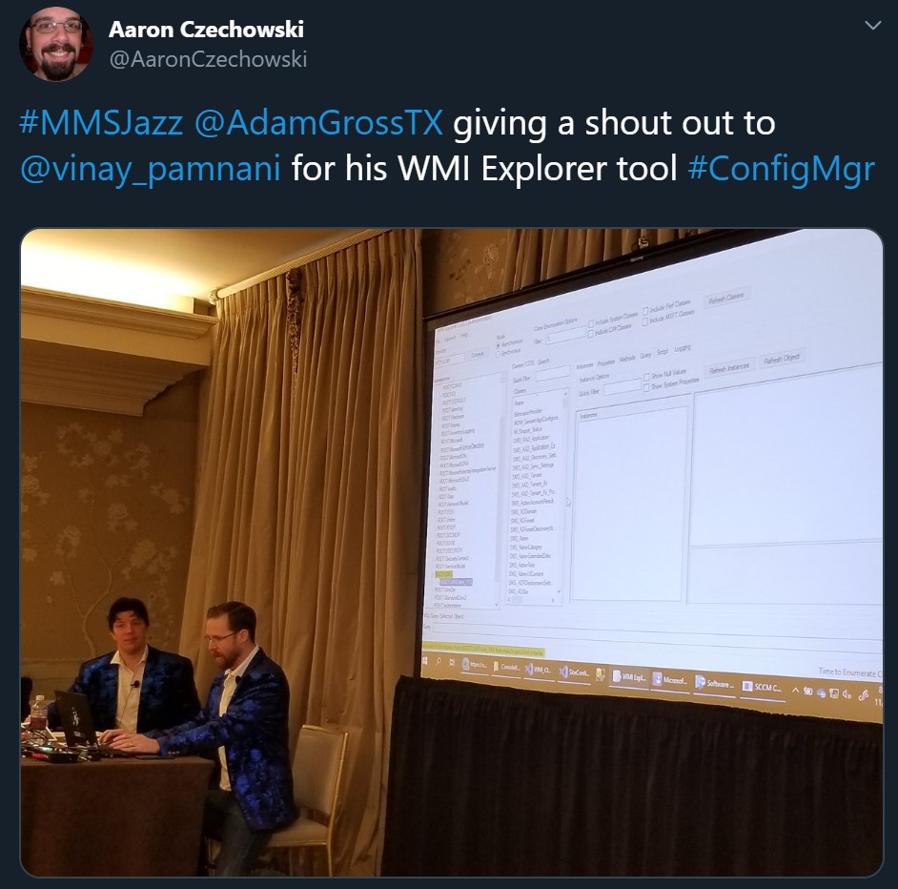
ConfigMgr AdminService
The AdminService HTTPS Interface to ConfigMgr
Uses WMI, but many functions are beginning to use Odata = speed!
Manage ConfigMgr over the Internet (and the security implications)
Scripting through the AdminService is possible through powershell
Makes MEM possible!

Slide 17
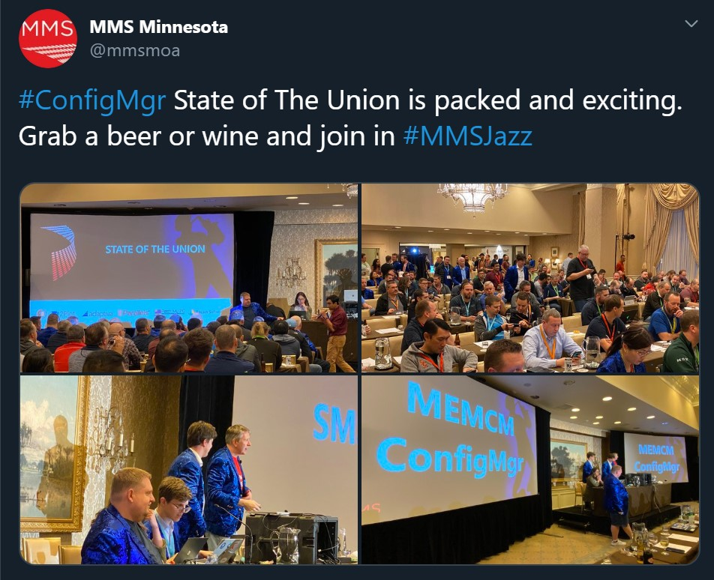
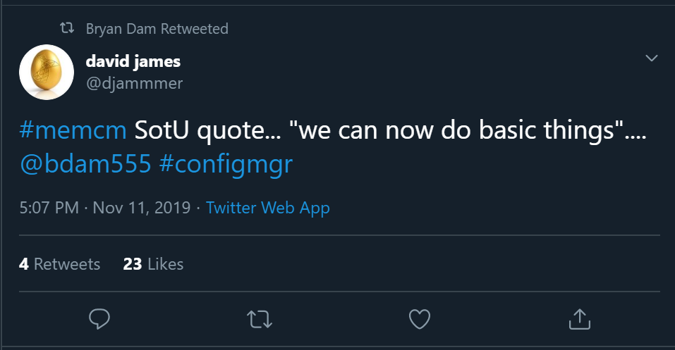
ConfigMgr State of the Union
Get an inside preview of the future of ConfigMgr
Insights into MEM, reporting, interface and functionality
A ConfigMgr web console is not coming
Product team is focusing on specific use cases (personas) for the web console
Intune + ConfigMgr = Microsoft Endpoint Management
New name, new licensing, still the same product you know and love
ConfigMgr is NOT dead

Slide 18
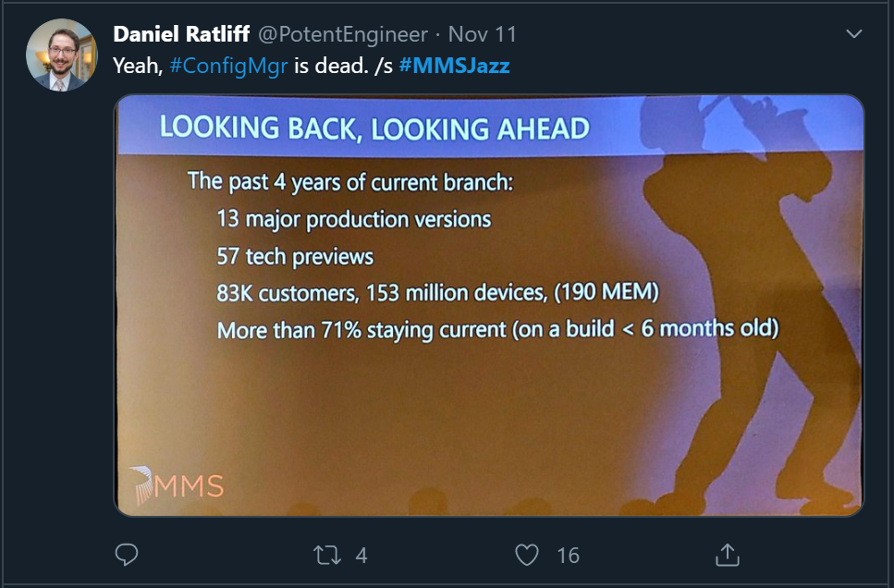
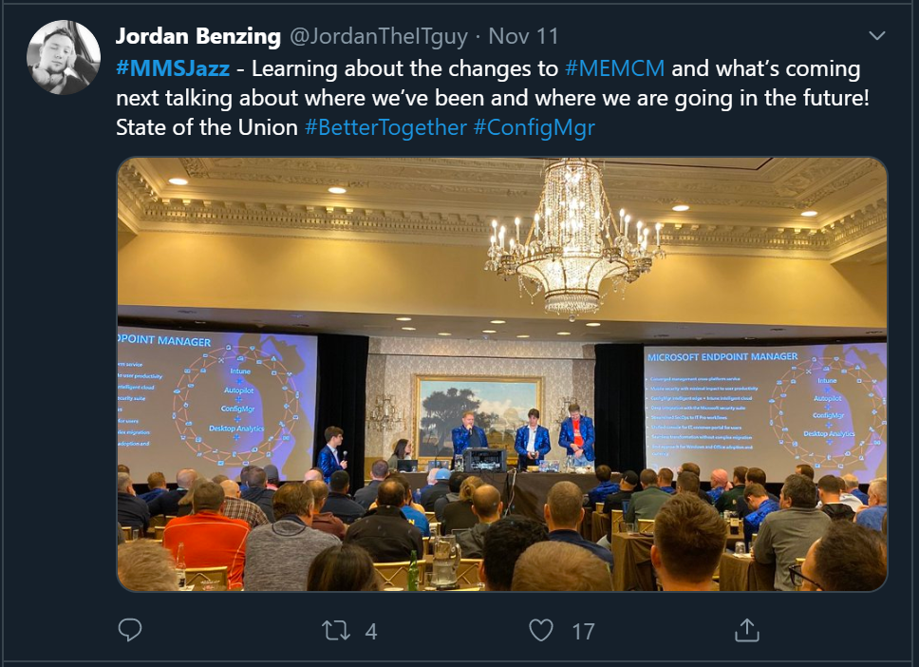
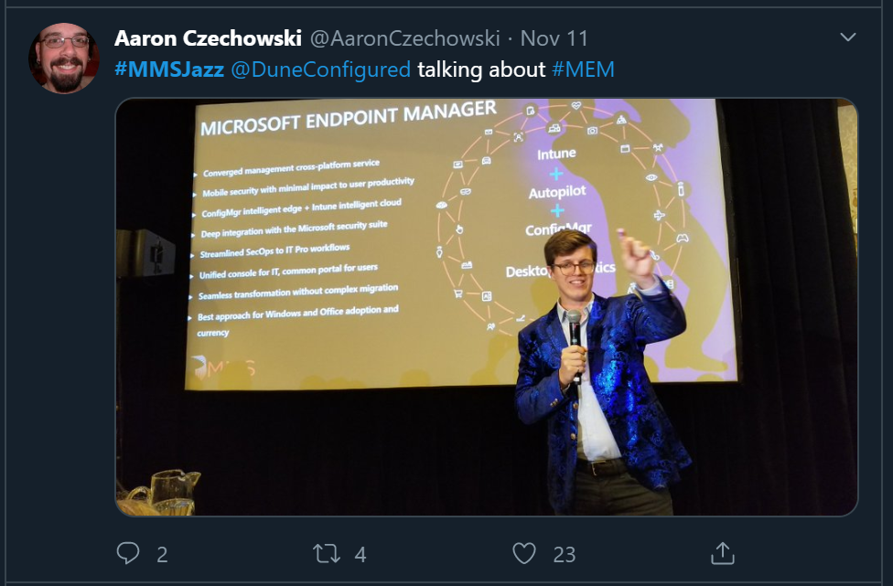
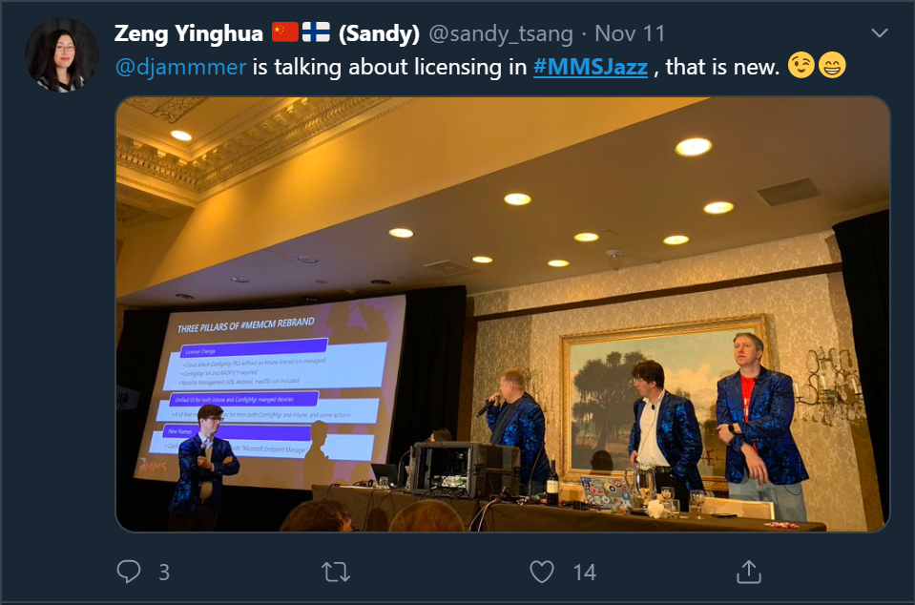
State of the Union

Slide 19
Day 2
November 12th, 2019

Slide 20
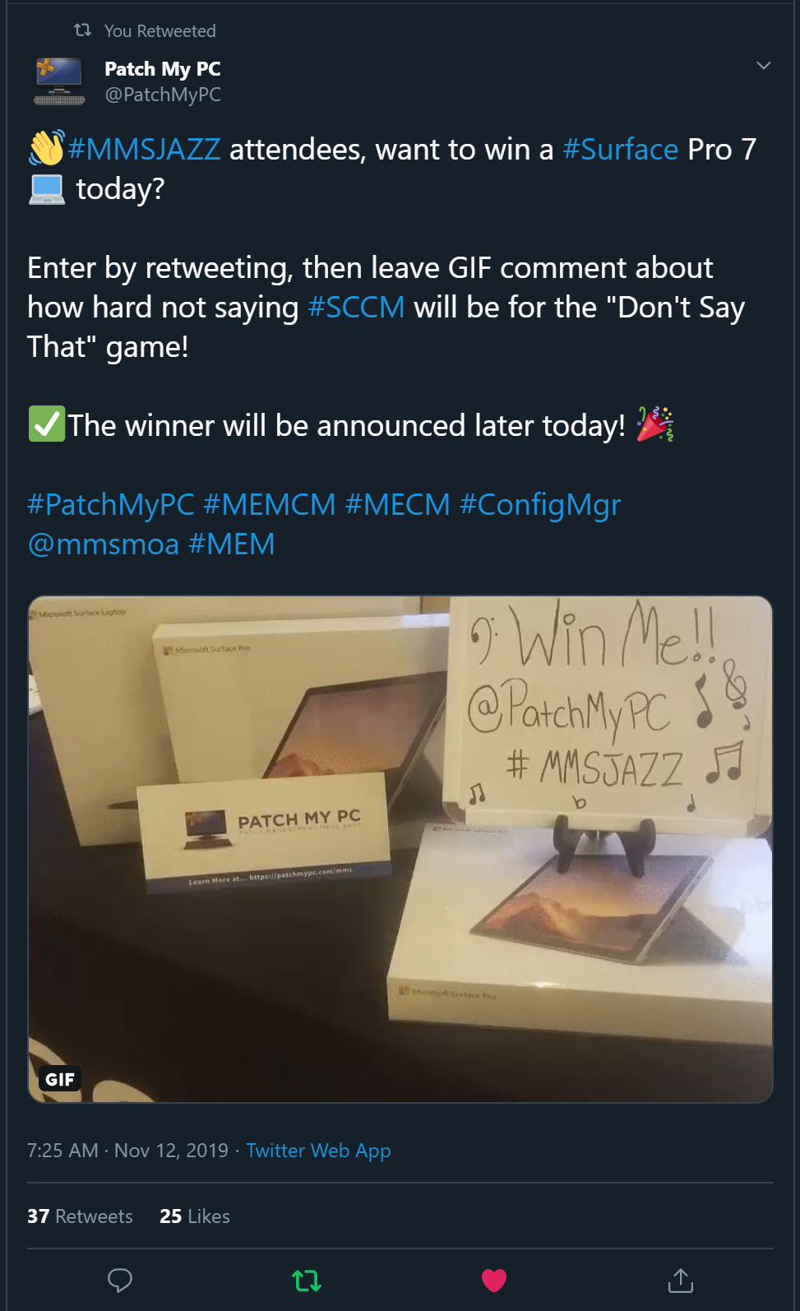
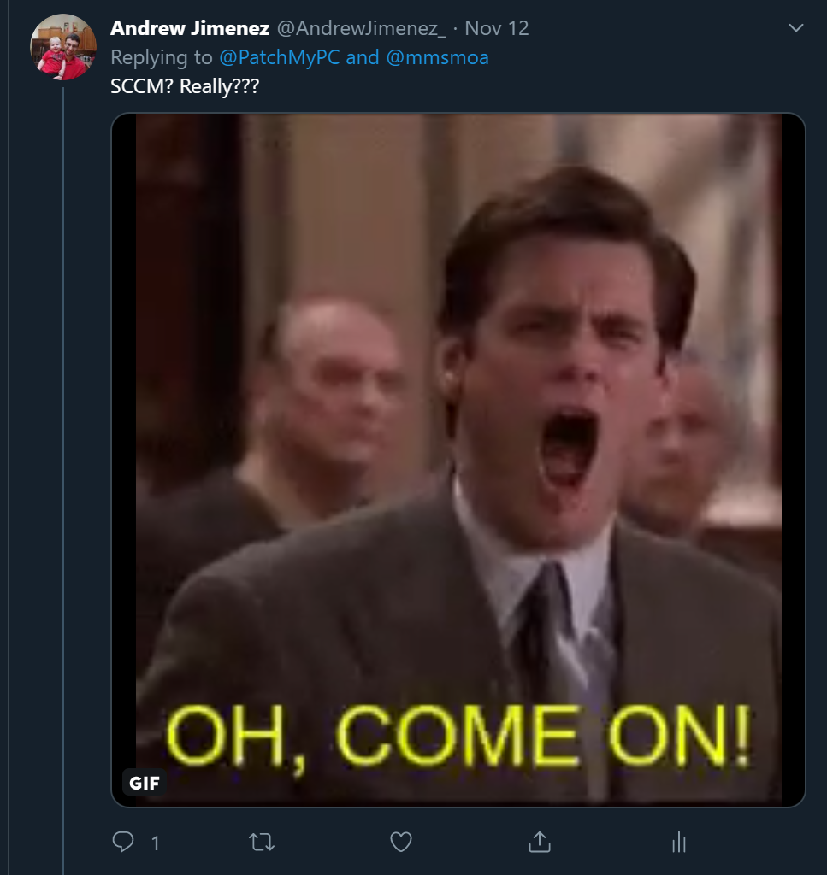
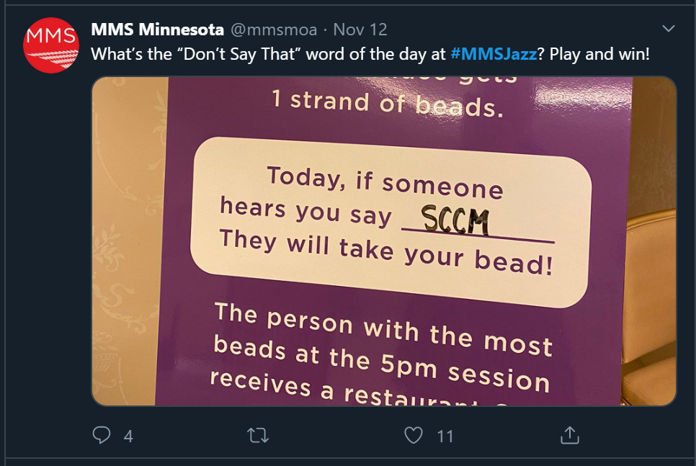
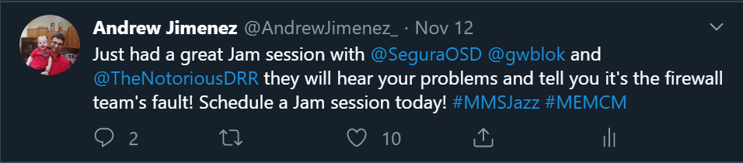
Day 2
Word of the day: SCCM…
Jam session with David Segura, Gary Blok, and Donna Ryan
ConfigMgr is innocent! Troubleshooting Software Installations
Tips and Tricks!

Slide 21
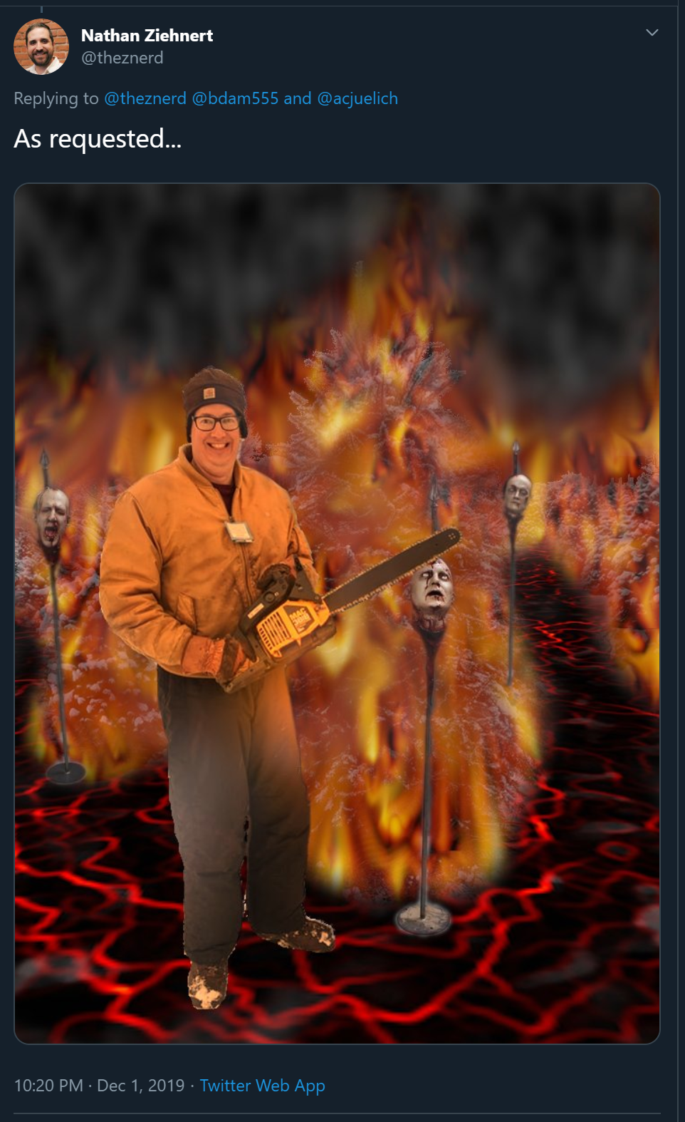
ConfigMgr is Innocent
Word of the day was scattered throughout the presentation
Tons of useful information on how ConfigMgr installs software
How to test packages
MSI, MSIX, EXE, PSAppdeployToolkit
Info about registry, filesystem, and bitness

Slide 22
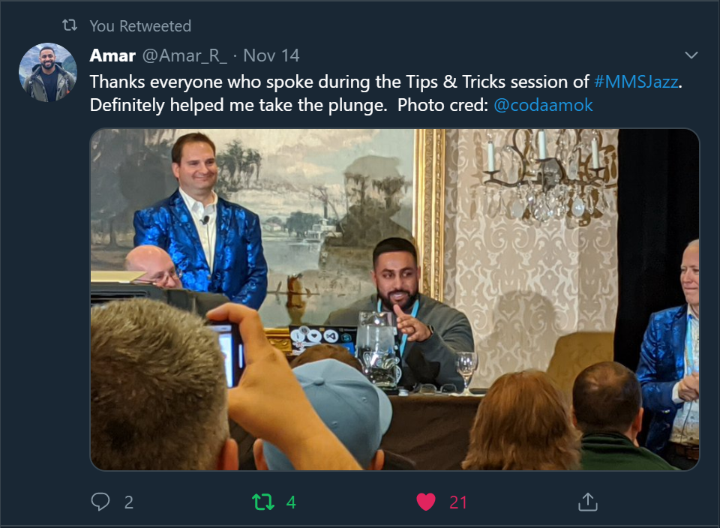
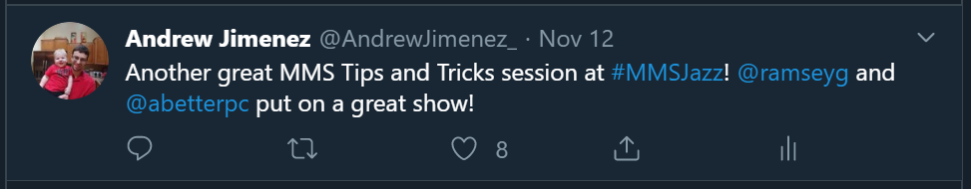
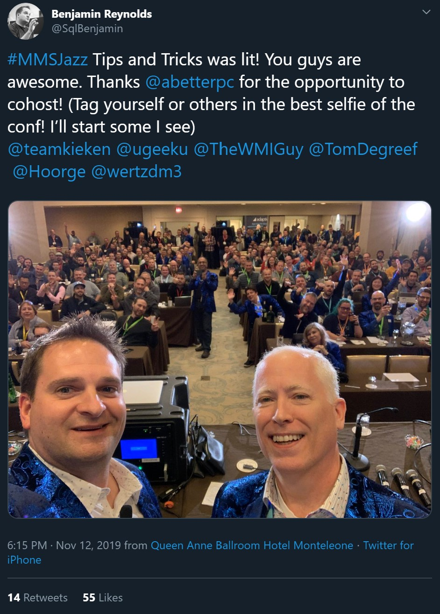
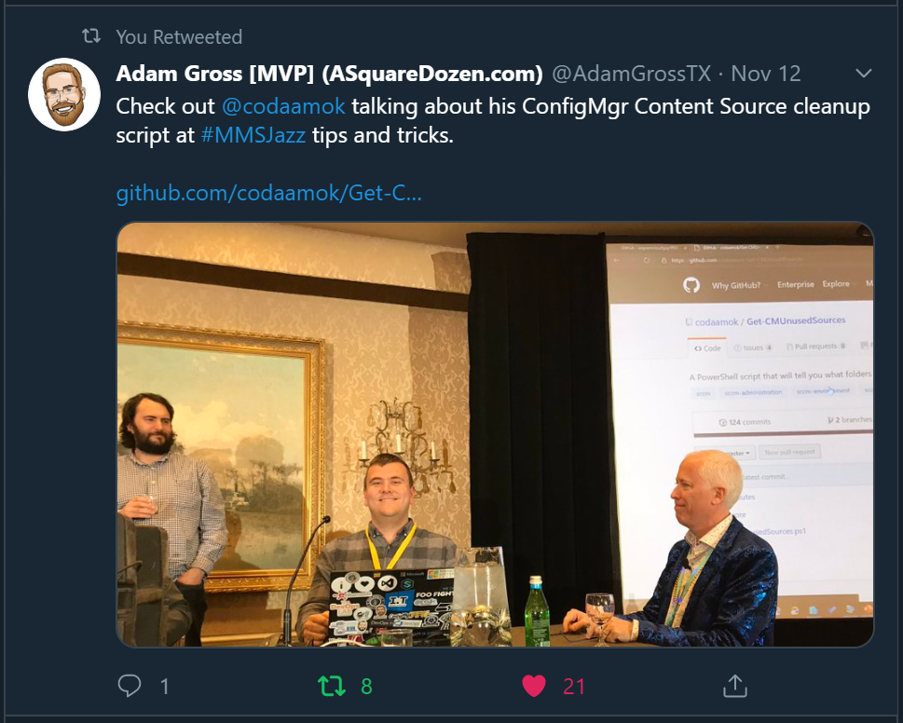
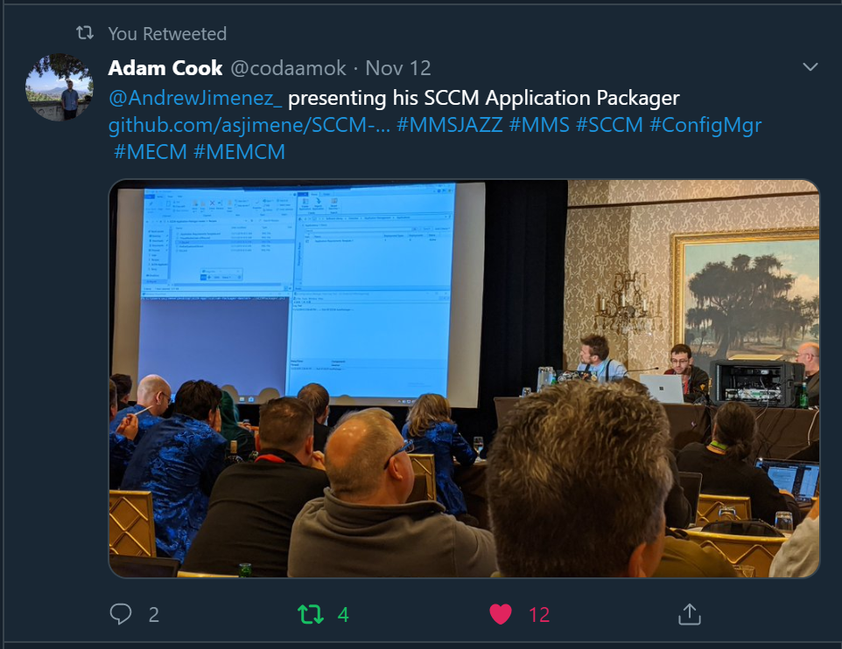
ConfigMgr Tips and Tricks

Slide 23
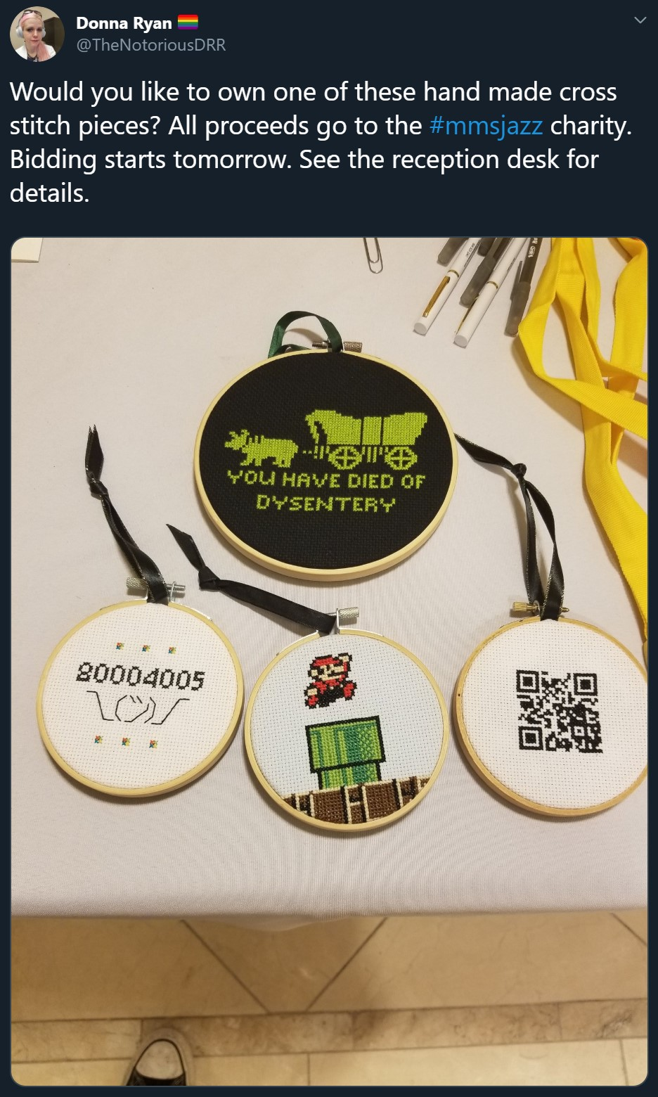
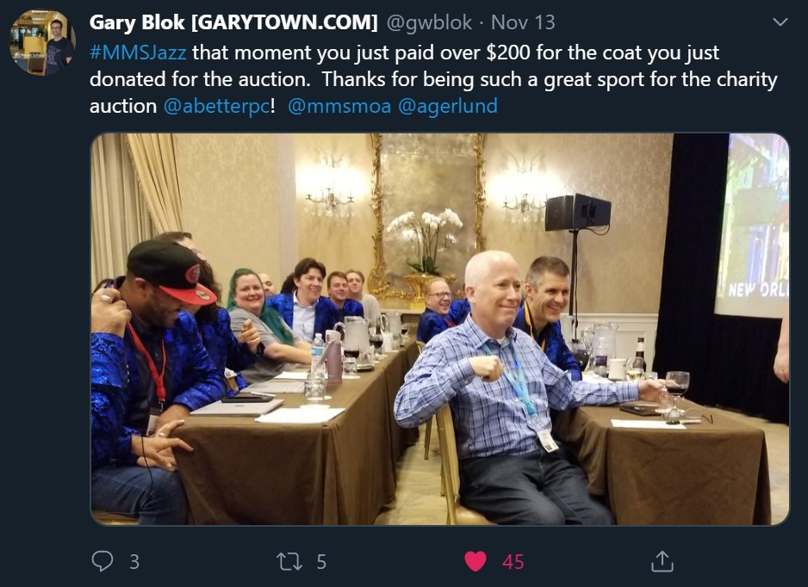
Tips, Tricks and Charity

Slide 24
Day 3
November 13th, 2019

Slide 25
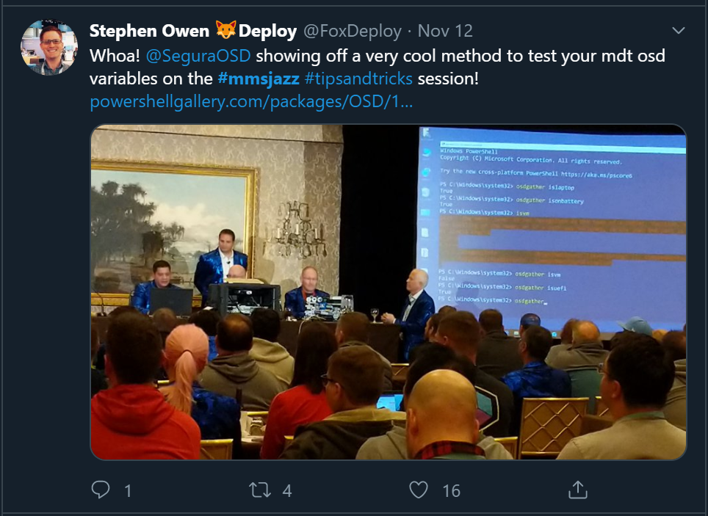
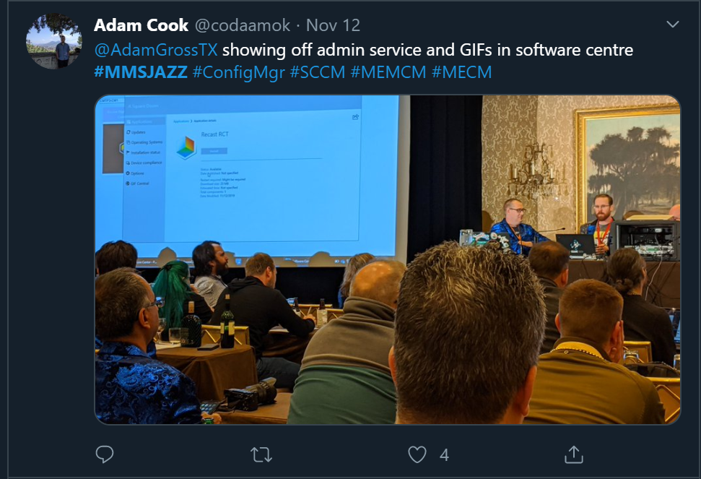
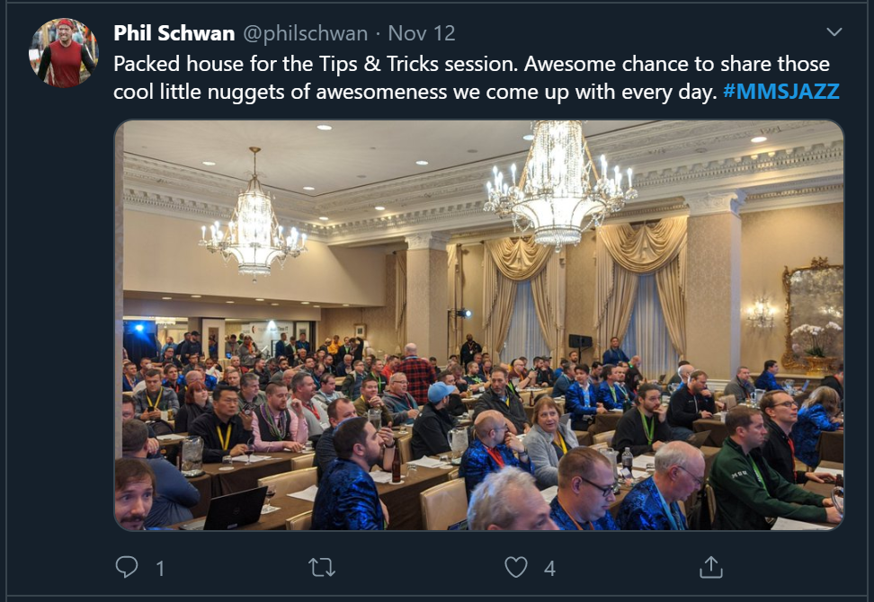
Day 3
Word of the day: Ignite
OSDBuilder & WIMWitch
ConfigMgr team Q&A

Slide 26
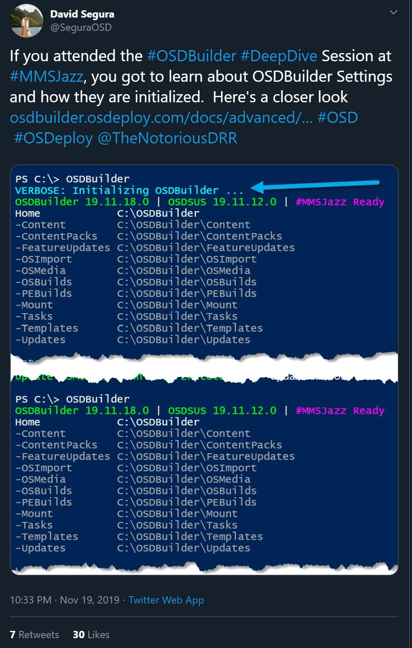
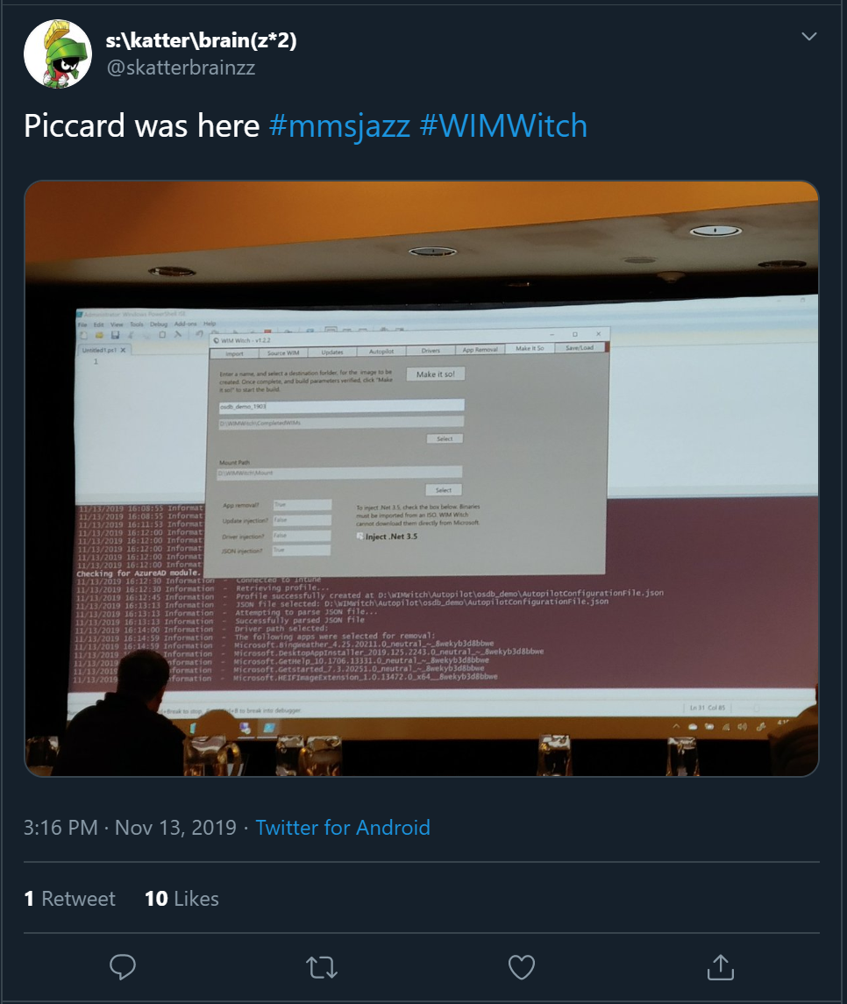
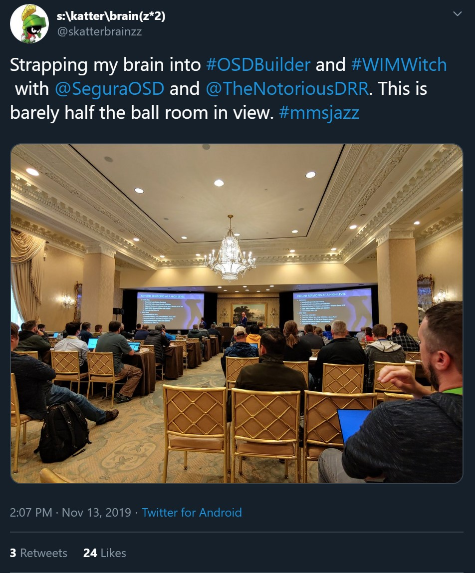
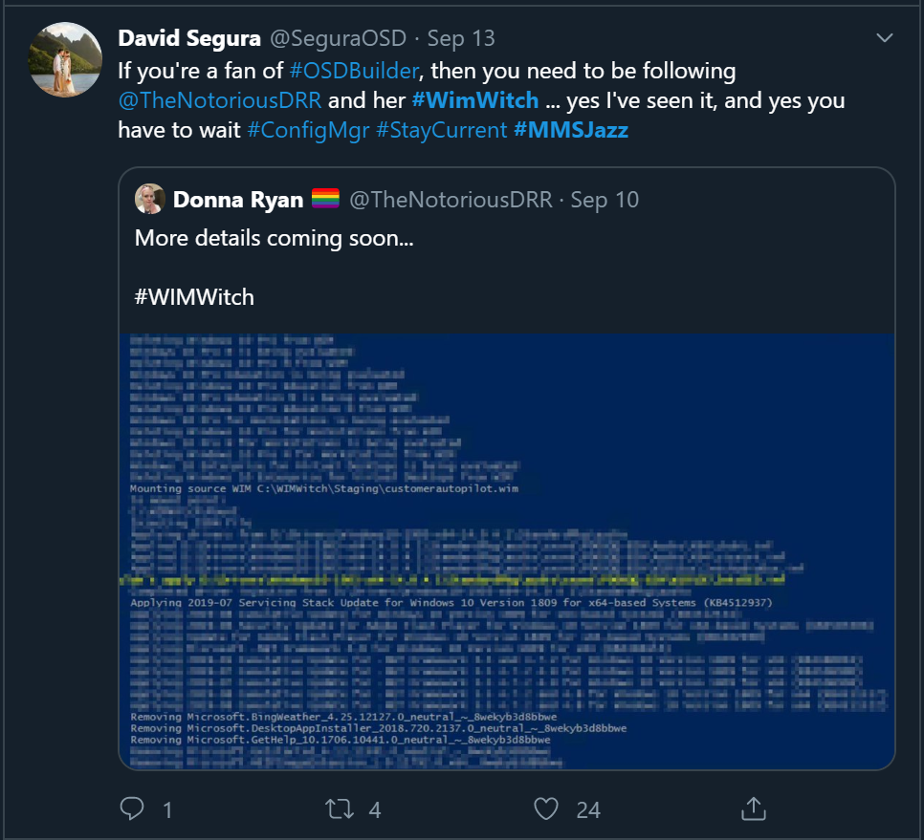
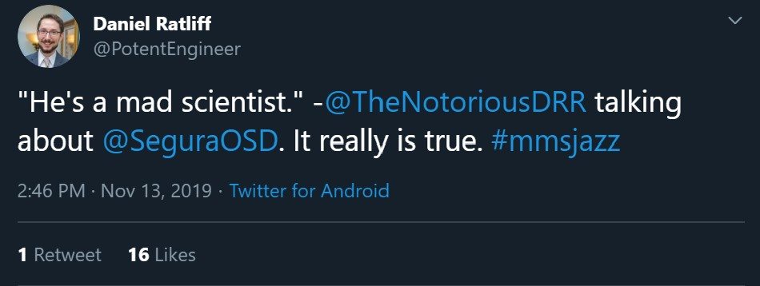
OSDBuilder

Slide 27



COnfigMgr Product Team Q&A

Slide 28
Takeaways

Slide 29
Takeaways
SCCM is dead! Long live ConfigMgr
Expect more integration between ConfigMgr and Intune
Take advantage of the product team! Yell at them ask them about gifs in software center, give dark mode! Colbert gif
The Speakers are all very approachable, knowledgeable and available. Talk to them, follow them on Twitter, ask questions, and provide feedback!
Eat! Snack! Drink!
Don't get bronchitis
And if you do…. Get a ton of cough drops

Slide 30


Takeaways
Get Social!
https://aka.ms/winadmins

Slide 31
Extended Q&A

Slide 32
Twitter Links
https://twitter.com/ramseyg/status/1192925507551191040?s=20
https://twitter.com/ramseyg/status/1193716382946467843?s=20
I’ll post the rest!

Slide 33
Section Header
This is the next section

Slide 34
Title
Line1
Bullet Level 1
Bullet Level 2
Bullet Level 3

Slide 35
Title
Code

Slide 36
Text Only with Border
Level 1
Level 2
Level 3

Slide 37
Text Only (Dark)
Level 1
Level 2
Level 3

Slide 38
Title
Text 1
Level 1
Level 2
Level 3
Text 2
Level 1
Level 2
Level 3

Slide 39
Title
Section 1
Section 2
Text
Level 1
Level 2
Level 3
Text
Level 1
Level 2
Level 3

Slide 40
Demo Title

Slide 41





























Slide 42






























Slide 43




























Slide 44




























Slide 45




























Slide 46




























Slide 47




























Slide 48























Slide 49
















